Slide 1
PBS LearningMedia Content Map
September-November, 2014
The Content Map is designed to help librarians and media specialists be the clearinghouse for using PBS LearningMedia in a school or district. These people can select whether or not any of these resources need to be sent on to specific teachers based on what the librarian knows is going on in the classroom. The librarian or media specialist knows shat teachers, what subjects, appropriate ages!
This map includes a calendar with weekly themes that will be reflected across each of PBS LearningMedia’s marketing channels from September to November.

Slide 2
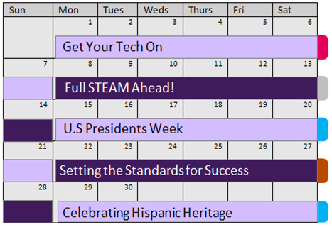
Weekly Content Themes: September
Week of 9/1: Get Your Tech On
This week marks the start of “Get Your Tech On 2” – a campaign designed to support educators as they integrate digital media/technology into their classrooms. Features resources address learning in the digital age.
Week of 9/8: Full STEAM Ahead!
This theme supports National Arts in Education Week by showcasing resources that help teachers bring the creative arts into STEM curriculum.
Week of 9/15: U.S. Presidents Week
In support of PBS’ new series The Roosevelts premiering this week, PBS LearningMedia will feature the U.S. Presidents (this includes new content from the program).
Week of 9/22: Setting the Standards for Success
This week’s featured resources are designed to support teachers as they integrate the National and Common Core State Standards into their lessons.
Week of 9/29: Celebrating Hispanic Heritage
To mark Hispanic Heritage Month, PBS LearningMedia will spotlight new Spanish-language resources alongside a rich collection of content about Hispanic history and culture.
Looking for additional content to feature this month? Here are a few key events to keep on your radar:
9/1 | Labor Day
9/6 | Flipped Learning Day
9/8 | International Literacy Day
9/7-13 | Nat’l Arts in Education Week
9/11 | Anniv. of September 11
9/15-10/15 | Hispanic Heritage Mon.
9/17 | Constitution Day
9/21 | International Day of Peace
9/23 | Autumnal Equinox
9/27 | Smithsonian Museum Day
Nat’l Childhood Obesity Awareness
Tech Theme
Art Theme
Social Studies Theme
Professional Development Theme

Slide 3
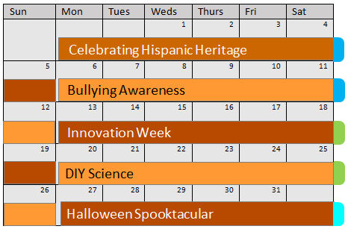
Weekly Content Themes: October
Week of 10/6: Bullying Awareness
This theme supports Bullying Prevention Month with resources that address cyber bullying, conflict resolution, and relationship-building.
Week of 10/13: Innovation Week
In support of PBS’ new series How We Got to Now premiering this week, PBS LearningMedia will feature content about innovation in the 21st century (this includes new content from the program).
Week of 10/20: DIY Science
This week, we will spotlight our robust library of “DIY” content to help science teachers create interactive learning experiences and engage students in hands-on activities.
Week of 10/27: Halloween Spooktacular
This theme will call attention to our new series of holiday collections – and give teachers an easy way to integrate the fun of Halloween into their lesson plans this week.
Looking for additional content to feature this month? Here are a few key events to keep on your radar:
10/2/1869 | Gandhi's Birthday
10/4-10 | World Space Week
10/5-11 | Nat’l Metric Week
10/12-18 | Earth Science Week
10/12-18 | Teen Read Week
10/13 | Columbus Day
10/13-17 | Nat’l School Lunch Week
10/16 | World Food Day
10/20 | Nat’l Day on Writing
10/19-25 | Nat’l Chemistry Week
10/25 | Make a Difference Day
10/31 | Halloween
Nat’l Bullying Prevention Mon.
Cyber Security Awareness Mon.
Science Theme
Social Studies Theme
All

Slide 4
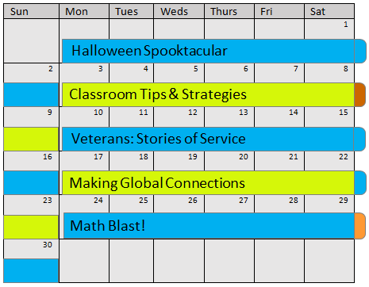
Weekly Content Themes: November
Week of 11/3: Classroom Tips & Strategies
This theme is designed to help teachers navigate the digital age of learning with practical tips, tactics, and digital tools.
Week of 11/10: Veterans: Stories of Service
In honor of Veterans Day (11/11) and the premiere of PBS’ new series, Navy Seals PBS LearningMedia will feature the stories about veterans from across the country (this includes new content from the program).
Week of 11/17: Making Global Connections
To mark Geography Awareness Week, PBS LearningMedia will be showcasing a fantastic series of resources focused around global literacy and diplomacy.
Week of 11/24: Math Blast!
This week’s theme spotlights of our top math collections and offers teachers a creative way to apply lessons in math to the Thanksgiving holiday.
Looking for additional content to feature this month? Here are a few key events to keep on your radar:
11/1-2 | Day of the Dead (MX)
11/2 | End of Daylight Saving Time
11/9/1989 | Fall of the Berlin Wall
11/11 | Veterans Day
11/16-22 | Geography Awareness Week
11/17-21 | American Education Week
11/19/1863 | Anniv. Gettysburg Address
11/27 | Thanksgiving
American Indian Heritage
Nat’l Alzheimer's Awareness Mon.
Nat’l Diabetes Mon.
All
Math Theme
Professional Development Theme
Social Studies Theme

Slide 5
Recommended Resources
The following resources reflect our weekly themes and represent some of the most dynamic content in the PBS LearningMedia library. We invite PBS Stations to integrate these resources into local marketing efforts. Featured resources are subject to change.
Week of 9/1 → Get Your Tech On
21st Century Learning | PBS LearningMedia | All
New Learners of the 21st Century | digital* media | 6-12
How to Make an Interactive Timeline | KQED | 6-13+
How to Make a Prezi | KQED | 6-13+
The Art of Creative Coding | Off Book | 9-12
Learning in the Digital Age | FRONTLINE | 9-13+
Engaging Students in Lecture and Lab | Getting Results | 11-13+
Teach Civic Engagement Using Social Media | KQED | 13+
Educaching | Classroom Close Up NJ | 13+
Changing Student Lives Through Tech | WGBH | 13+
Week of 9/8 → Full STEAM Ahead!
Jazz in the Middle | Spark* | K-13+
Movable Books: Pop Ups | NJN | 3-12
Puppet Power | SciGirls | 5-8
The Art of Math | WGBH | 6
The Art of Data Visualization | Off Book | 6-12
Rapping On Science | Youth Radio | 6-13+
Monet’s Ultraviolet Eye | It’s Okay to be Smart | 6-13+
The First Beat Making Lab | Beat Making Lab | 6-13+
Zeega: Interactive Video | KQED Art School | 6-13+
Teachable Moment: Gravity | Fast Forward | 9-12
Week of 9/15 → U.S. Presidents Week
Looking for Lincoln | WNET | K-12
Presidential Portraits | Bridgeman | K-13+
Diplomacy | Various | K-13+
First Ladies of the United States | Various | K-13+
President for a Day | PBS KIDS | 3-8
Roosevelt Winner in Landslide | Bridgeman | 5-13+
GW’s First Inaugural Speech | NARA | 6-13+
Separation of Powers |Constitution USA | 9-12
TBD | The Roosevelts | Florentine Films
TBD | 60 Second Presidents
Week of 9/22 → Setting the Standards for Success
Professional Learning for the CCSS | Nashville PTV| K-13+
Teaching NGSS Engineering Design | WGBH | K - 13+
Journalism and the Common Core | ThinkTV | 6-12
The Design Process: | NOVA Education | 6-12
Making the Case | WGBH | 9-13+
Differentiating Instruction |WGBH | 9-13+
Guide to the CCSS | KET | 9-13+
Standards as a Common Language | WNET | 13+
Common Core Video Series | WNET | 13+
Teaching Planetary Sciences | WNET | 13+

Slide 6
Recommended Resources
The following resources reflect our weekly themes and represent some of the most dynamic content in the PBS LearningMedia library. We invite PBS Stations to integrate these resources into local marketing efforts. Featured resources are subject to change.
Week of 9/29 → Celebrating Hispanic Heritage
Flamenco Dance Studio Field Trip | WPBT2 | PreK-3
Oh Noah! | WNET | K-2
Hispanic Exploration in America | Library of Congress | 4-12
Latino Americans | LPB/WETA | 4-13+
Webinar – Latino Americans | LPB | 4-13+
Baseball and Social Change | WGBH | 5-8
Deciphering the Maya Code | NOVA | 5-12
The Graduates / Los Graduados | ITVS | 9-12
The Storm that Swept Mexico | LPB | 9-12
TBD | NEW: Spanish-language content
Week of 10/6 → Bullying Awareness
Pump Your Pistons & Listen | Thomas & Friends | PreK
So Funny I Forgot to Laugh | Arthur | PreK-4
Martha Walks the Dog | Martha Speaks | K-5
Stand Up to Bullying | WSKG | 2-6
Crumpled Paper Bullying | News Hour | 2-13+
The Teenage Brain | FRONTLINE| 6-8
Not in Our Town | NIOT | 6-13+
NFL Bullying Case Sparks Debate | PBS NewsHour | 7-12
Cyber-bullying | UEN | 7-12
Block the Bullying | Classroom Close-up NJ | 13+
Week of 10/13 → Innovation Week
Be Inspired, Be an Innovator! | PBS LearningMedia | 3-13+
Sign Language Translator Glove | DragonflyTV | 4-6
Wearable Robots | NOVA scienceNow | 5-13+
Extreme By Design | Hawkview Pictures | 6-12
Adaptive Technologies | Medal Quest | 6-12
Secrets of Selfridges: | Pioneer Productions | 6-12
Cultivating Innovative Thinking | PBS LearningMedia | 6-12
The Design Process | WGBH | 6-12
Process of Innovation | The Henry Ford | 6-13+
TBD | We Got to Now
Week of 10/20 → DIY Science
Experimenting with Seeds | PATBW | PreK
MAKERS Collection | Various | PreK-12
Think Garden |KET | 3-5
Mission: Solar System | Design Squad | 3-8
Experimenting with a Pendulum | Zoom | 3-8
Coconauts | TPT | 4-6
The Catapult Project | WNET | 5-12
SciGIrls Collection | TPT | 5-8
Cornstarch Comes Alive | SciFri | 6-8
TBD | NEW Nature Works Everywhere

Slide 7
Recommended Resources
The following resources reflect our weekly themes and represent some of the most dynamic content in the PBS LearningMedia library. We invite PBS Stations to integrate these resources into local marketing efforts. Featured resources are subject to change.
Week of 10/27 → Halloween Spooktacular
Halloween Spooky Science Special | Sid the Science Kid | PreK-1
Happy Halloween! | Peg + Cat | PreK-2
Printable: Halloween | Super Why! | K-3
Haunted House | The Electric Company | 1-3
It's Halloween Night | Fizzy's Lunch Lab | 1-4
Haunted House for Good | Youth Radio | 3-8
DIY: How to Make a Clown Face | Circus | 5-8
Why Do Things Sound Scary? | Digital Studios | 6-13+
The Zombie Autopsies | News Hour | 8-12
Supernatural Elements in Shakespeare | WNET | 8-12
Week of 11/3 → Classroom Tips & Strategies
Flipped Learning Collection | Various | PreK-13+
New Learners of the 21st Century | TPT | 6-12
Digital Tools | Collection | KQED | 6-13+
Build Relationships | Ted Talks | 13+
Use Appropriate Tools Strategically | WLJT | 13+
edtalk | CPB | 13+
How to Integrate Tablets, Devices, More | PBS LM | 13+
Powerful Learning with Digital Media | NASA | 13+
Learning in the 21st Century | WNET | 13+
TBD | Webinar Collection
Week of 11/10 → Veterans: Stories of Service
WWII Prairie Memories | Prairie Public | 3-12
Soldiers, Veterans, and War in American Life | Various | 4-12
Kortney Clemons: A Veteran's Journey | Medal Quest| 6-12
Servicemen's Readjustment Act | NARA | 6-13+
Tammy Duckworth’s Story | Coming Back… | 6-12
Military Families | PBS NewsHour | 7-12
Facing It, by Yusef Komunyakaa | Poetry Foundation | 7-12
D-Day Veterans Return to Normandy | PBS NewsHour | 7-12
The Costs of War, Bedford, VA | D-Day 360 | 9-12
TBD | Navy Seals – Their Untold Story
Week of 11/17 → Making Global Connections
Around the Globe: France | Various | K-12
Around the Globe: China | Various | K-12
Around the Globe: UK | Various | K-13+
Social Studies/History through Music/Dance | Various| K-13+
Global Learning and Awareness | Various | 6-13+
History of Geography | WPSU | 7-12
What Can You Do With Geography? | ZD Films | 7-13+
Window into Global History | Wide Angle | 9-12
Migration Sensations | Faces of America | 9-12
TBD | Black Pharaohs

Slide 8
Recommended Resources
The following resources reflect our weekly themes and represent some of the most dynamic content in the PBS LearningMedia library. We invite PBS Stations to integrate these resources into local marketing efforts. Featured resources are subject to change.
Week of 11/24 → Math Blast!
Math in the Bath | Peg + Cat | PreK-2
Math Is AweSum Collection | PBS LearningMedia | PreK-13+
Move That Math | Kids in Motion | K-5
Khan Academy Collection | Khan Academy | 3-12
Percent as a Rate | I <3 Math | 4-8
Math at the Core | WGBH | 5-8
Adding Negative Numbers | PBS Math Club | 6-9
Statistics and Probability | WTCI | 6-13+
Additive Inverse | UEN | 7
Get the Math | WNET | 7-10

Slide 9
Questions?
Please contact Chris Seifert, MontanaPBS: chris@montanapbs.org

